Slide 1
Capstone Project – Battle of the Neighborhoods Predicting locations for a new pet supply store in the Austin, Tx area
Michelle Skibitzki
March 9, 2020

Slide 2
Introduction
Background
A friend is looking for the best place in or near Austin, Texas to open a new family owned Pet Supply Store.
Austin and the surrounding suburbs (Cedar Park, Georgetown, Round Rock, etc) are generally known to be pet friendly. There are several "large box store" pet supply places already, but the friend feels that providing a more personalized experience and potentially carrying more unique items/foods in addition to the most popular items at the box store places, he has the potential to bring in the needed customer base to do well.
Business Problem
The friend is looking for the overall best areas near Austin to place his store where there is not already a large population of other pet stores.
Solution
Analyze the data from Travis and Williamson counties using Foursquare to determine where the largest grouping of population is located and correlate that with the existing pet stores in Travis and Williamson counties, given a 25 mile radius from the center of each major city in those two counties. Utilize k-means for clustering and folium mapping for visualization purposes.

Slide 3
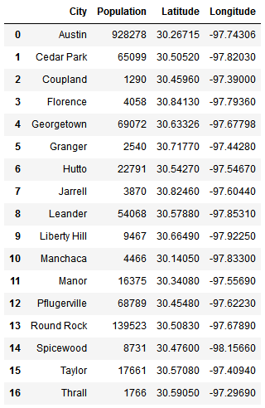
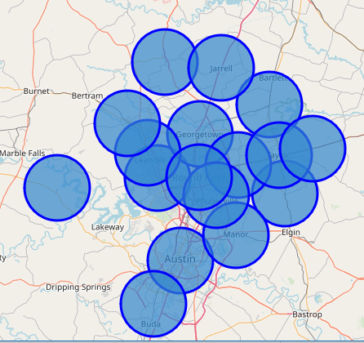
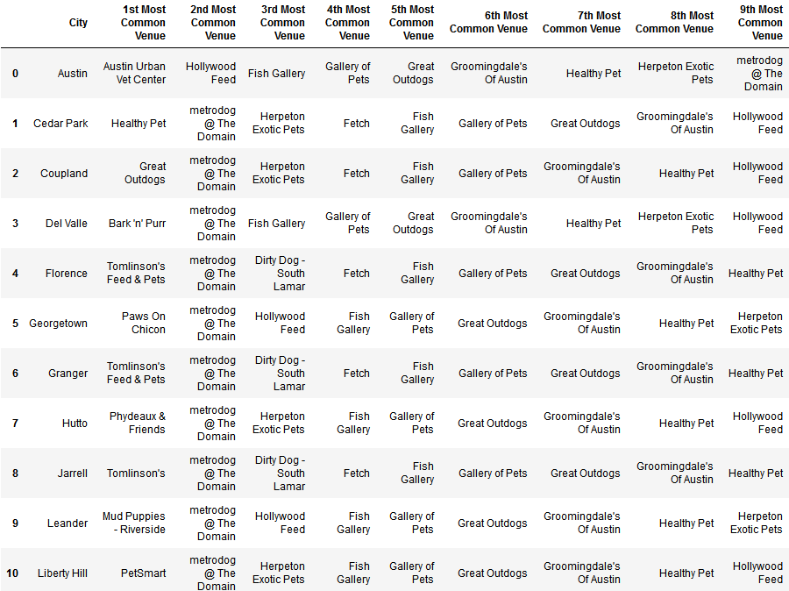
Data
Using the geo coordinates provided by https://latitude.to/articles-by-country/us/united-states/ we will find the centers of Travis County and Williamson County. Then merge the coordinates to find the overall “center” of the combined counties. This will be used as the starting point for mapping the major cities.
Pulling data from from https://www.zip-codes.com for Travis and Williamson counties, that gives the overall population of the major cities within those counties and their geospatial centers and use folium to show them on a map.
Next using those latitude and longitude coordinates, query foursquare and massage the data to provide the most common pet store places that people from each of the major cities tended to visit.

Slide 4
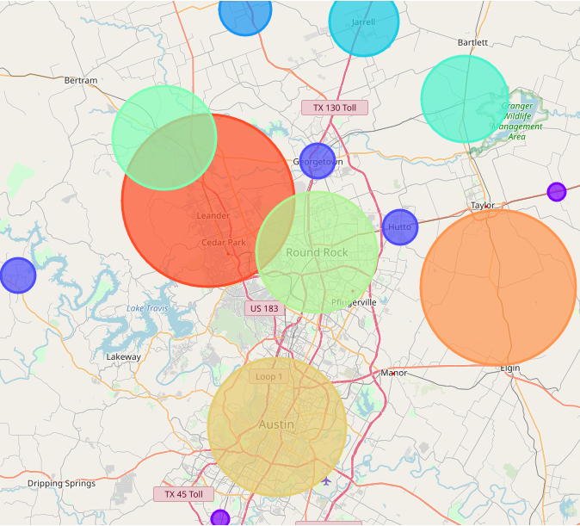
Methodology
Data Cleaning: The data cleaning process for each of the sources of data are done separately. The focus will be entirely on Travis and Williamson counties within the state of Texas.
Data will be pulled from https://www.zip-codes.com to determine the major cities and their corresponding population within Travis and Williamson counties. That data will be the population influence part of the problem. After visualizing the location of each city, we can correlate the population data.
Foursquare will be used to pull in the location of all pet stores located within a 25 mile radius of each of the major cities identified.
The methodology will be Knn processing to produce the ideal cluster grouping to best represent the locations of the existing pet stores, and then correlate that back to the population data. This will help identify the best city location for a new pet store.
Results
With our clusters established, this dataframe is merged with the total scores data to provide us with our final pieces of criteria in selecting the appropriate neighborhood(s)
All data gathered was put through k-Means processing and mapped back into folium to obtain a mapping of the primary locations for existing pet stores based on popularity and population.
Discussion
For the data presented, the following observations and recommendations can be made
Based on the criteria given by the friend and the cluster data, the main area recommendation would be around the Pflugerville to Manor area.
A secondary recommendation can be made for any area along US-183 between Cedar Park and Austin. This area has more overall competition from Cedar Park, Round Rock and Austin, but fewer pet stores in the exact area.
A third recommendation would be for any area along the IH-35 corridor from Pflugerville down into Austin.

Slide 5
Conclusion
Based on the mapping data and information provided, the best location to start a new Pet Supply store where there is not already a large number of stores would be in the Pflugerville area along the I-130 corridor to Manor.
This is a first-order solution to the question “Where is the best place to open a new pet supply store near Austin, Texas?” Using public datasets, we are able to, at least partially, address a few factors we have mentioned at the beginning: population and existing saturation of pet stores. We also carry out a very simple competitor analysis based on the distribution of pet stores in the chosen Travis and Williamson counties.
Further analysis would need to take into consideration cost of opening the store in the locations, along with ease of access to the business at those locations.

